Slide 1
All About The Beatles
(1962 – 1970)

Slide 2
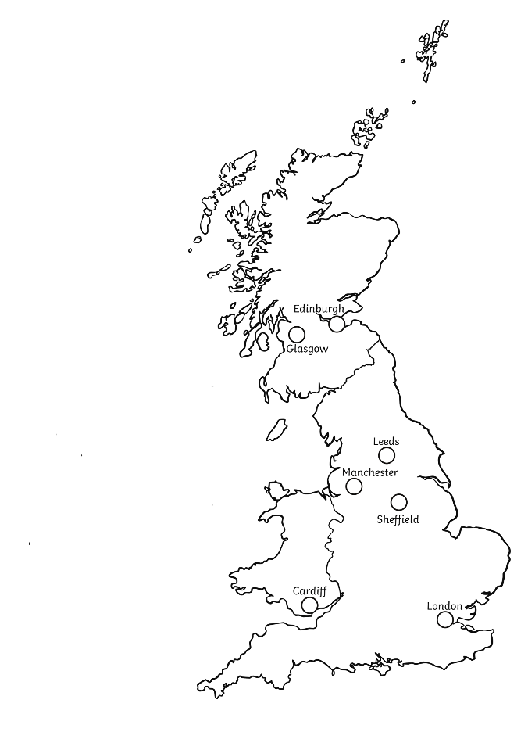
Who Were The Beatles?
The Beatles were a very famous UK rock band in the 1960s. They were famous all over the world.
There were four members of the band: John Lennon, Paul McCartney, Ringo Starr and George Harrison.
They all came from Liverpool.
They were one of the first bands to write their own songs and music.
Their huge fan following was known as ‘Beatlemania’.
Liverpool

Slide 3
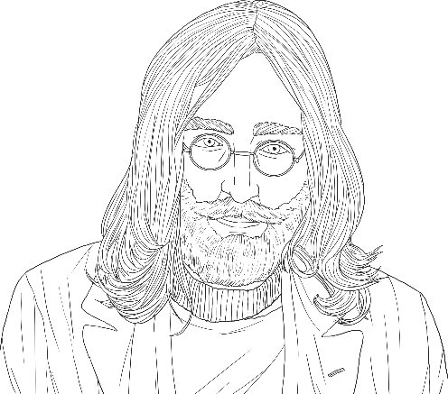
John Lennon
John Winston Lennon was born on the 9th of October 1940 during the Second World War.
His middle name was inspired by Winston Churchill, who was Prime Minister at the time.
He played the guitar (and later on the piano) in The Beatles.
He wrote, or collaborated on, many of the songs that the band performed, including ‘Help!’ and ‘A Hard Day’s Night’.
After the band split, he went on to be a successful solo artist. ‘Imagine’ was one of his most famous songs.

Slide 4
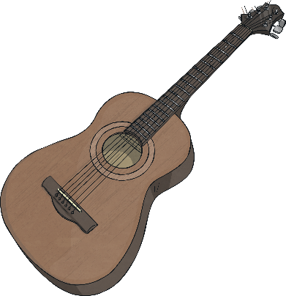
John Lennon
He married Cynthia Powell in 1962 and had a son, called Julian, in 1963. They divorced in 1968.
He married Yoko Ono in 1969 and had a son, called Sean, in 1975.
John spent a lot of time when he was married to Yoko protesting against war, especially the Vietnam War. The song ‘Give Peace a Chance’ became a song linked to the anti-war movement of the 1970s.
He was killed in December 1980, in New York, by an obsessed fan.

Slide 5
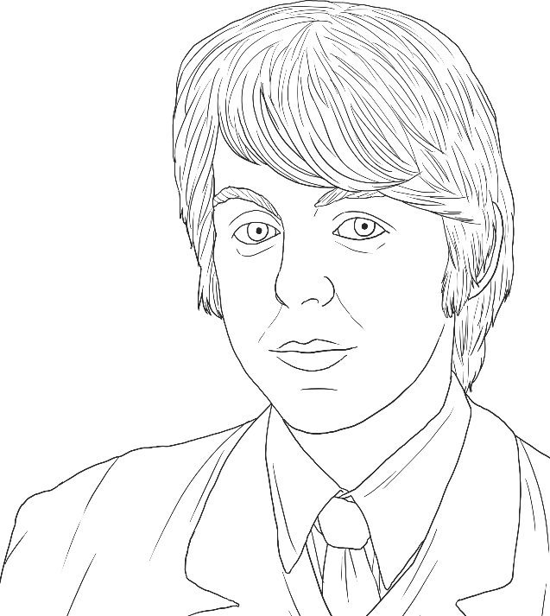
Paul McCartney
Sir James Paul McCartney was born on the 18th of June 1942.
He started writing songs when he was sixteen and wrote, or collaborated on, many of The Beatles’ songs. Arguably, his most famous song is ‘Yesterday’. Other songs include, ‘Can’t Buy Me Love’, ‘Hey Jude’ and ‘Let It Be’.
As well as writing songs, McCartney was bass guitarist and one of the vocalists in The Beatles.

Slide 6
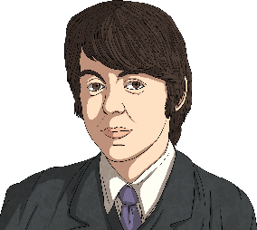
Paul McCartney
After The Beatles split up, McCartney formed his own band called Wings. The band released many popular rock songs, including ‘Live and Let Die’, which became a James Bond song for the film with the same name.
In 1997, McCartney was knighted by The Queen for his services to music.
He married Linda Eastman in 1969 – they had several children together, including his daughter, Stella, who became a famous fashion designer.
Fun fact:
Paul McCartney has a minor planet (planet 4148) named after him!

Slide 7
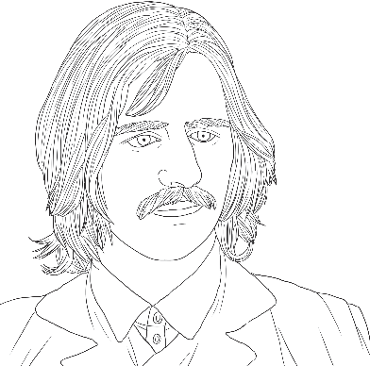
Ringo Starr
Born on the 7th of July 1940, Ringo Starr’s real name was Richard Starkey.
He played the drums in The Beatles and occasionally sang lead vocals. One of the songs he is most famous for singing is ‘Yellow Submarine’.
He was not one of the original Beatles – he was in a band called Rory Storm and the Hurricanes but quit in 1962 to join The Beatles.
When The Beatles broke up, he released his own music. His singles included, ‘It Don't Come Easy’ and US number ones ‘Photograph’ and ‘You're Sixteen’.
Between 1984 and 1986, he was the narrator for the first two series of Thomas the Tank Engine & Friends in the UK.
He was knighted in the 2018 New Year Honours List, for his contribution to music.
He married twice and has three children, eight grandchildren and one great-grandchild!

Slide 8
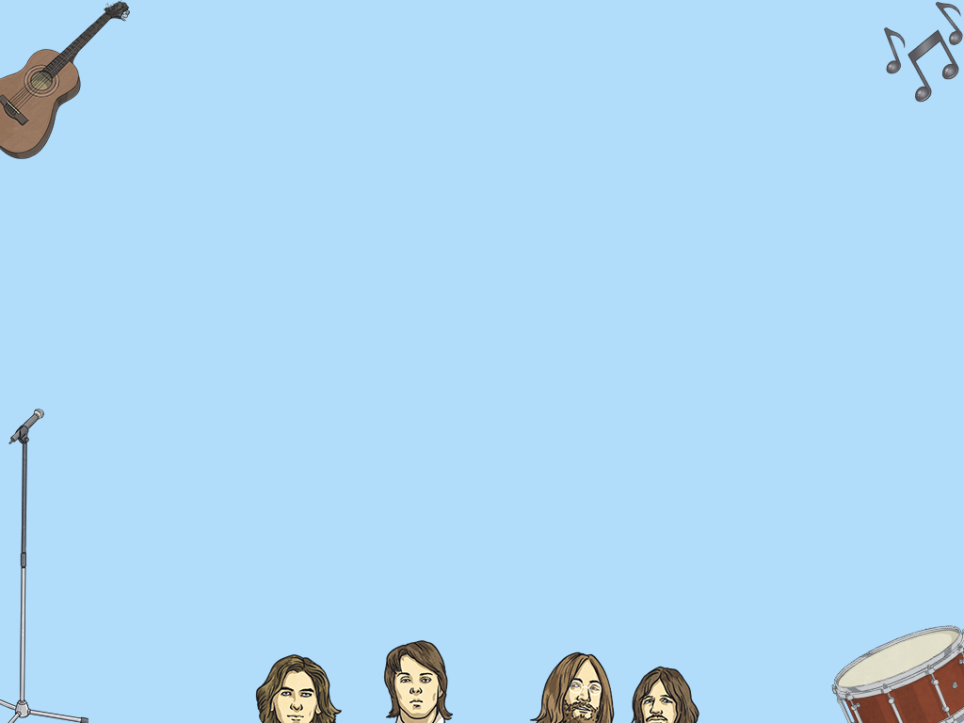
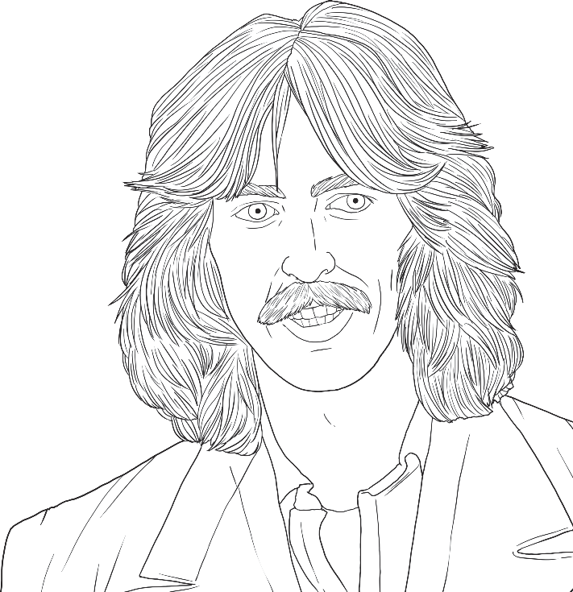
George Harrison
George Harrison was born on the 25th of February 1943.
He was the lead guitarist of The Beatles but he was also known for music and film production.
Although most of the band’s songs were written by Paul McCartney and John Lennon, Harrison did compose some of them, e.g. ‘While My Guitar Gently Weeps’ and ‘Here Comes The Sun’.

Slide 9
George Harrison
After The Beatles, he continued to work in the music industry, releasing singles and albums as a solo performer and collaborating with other famous musicians, including Eric Clapton and Bob Dylan.
He was asked by Ravi Shankar (a famous Indian musician), to raise awareness about a war in Bangladesh. In 1971, he helped organise a pair of benefit concerts, referred to as ‘The Concert for Bangladesh’. He, together with many other musicians, performed at these live concerts. They helped provide food for the refugees of the war.
He died from cancer in 2001.
A year after he died, a ‘Concert for George’ was held in his memory. All the profits went to charity.

Slide 10
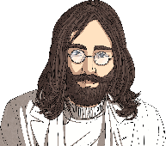
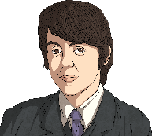
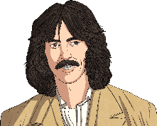
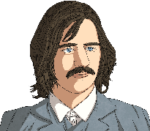
The Creation of The Beatles
In 1957, Paul McCartney and John Lennon first met and Paul joined John’s band – The Quarrymen.
Almost a year later,George Harrison also joined John’s band.
In 1960, John’s friend Stuart Sutcliffe joined The Quarrymen. Following this, the name of the band was changed several times. Band names included, The Beatals and the Silver Beetles. They finally became The Beatles only eight months later and Pete Best became their drummer.
In 1961, the band started playing gigs in Liverpool at the Cavern Club. In July that year, Stuart Sutcliffe quit the band.
In 1962, Ringo Starr replaced Pete Best as the band’s drummer. This was the final line-up of The Beatles and they started recording their music. That year, they recorded and released their first single ‘Love Me Do’, which reached number 17 in the charts.

Slide 11
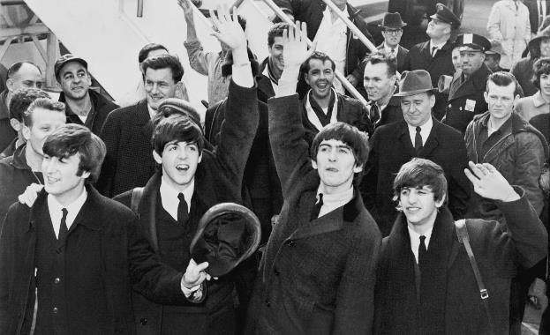
Fame
It was at this point that The Beatles shot to stardom. Released in January 1963, ‘Please Please Me’ became their first number one single and their album of the same name was at the top of the charts for six months. They released two albums in total this year, which solidified their fame in the UK.
Soon, The Beatles became internationally famous. In 1964, when they visited America for the first time, their first television performance was watched by around 73 million people. Their first film, ‘A Hard Day’s Night’, premiered in London in the summer.
In 1965, The Beatles held an outdoor concert in New York, which broke records due to the size of their audience – around 55,000 people attended!
“The Beatles in America” by United Press Internationais licensed under CC BY 2.0

Slide 12
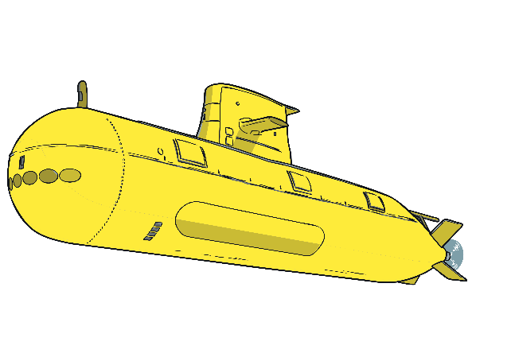
Films
As if being in one of the world’s most famous bands wasn’t enough, The Beatles also made five films!
A Hard Day’s Night is about the fans and Beatlemania.
Help! is a comedy-adventure film, which shows the band trying to record a new album, whilst protecting Ringo Starr from people who are chasing him (including some mad scientists).
Magical Mystery Tour is a surreal adventure about the band going on a coach tour and experiencing strange events caused by magicians.
Yellow Submarine is an animated fantasy, set in a land called Pepperland, where The Beatles (the heroes of the story) protect the land from the Blue Meanies, who are trying to conquer it.
Let It Be is a documentary film about the band
rehearsing their songs and playing to live
audiences.
Each of these films also had an album
released to go alongside them.

Slide 13
Beatlemania
The band rapidly become extremely famous around the world. The press (newspapers, radio and television) called The Beatles’ fame ‘Beatlemania’.
They became so famous that they began to travel by armoured car to protect themselves from excited fans.
Their fame also started to cause problems in some live concerts, where the screams of their fans were so loud that their songs couldn’t be heard over them!
During their last few years together as a band,
the group stopped touring.

Slide 14
Life After The Beatles
Members of the Beatles began to pursue their own interests outside of the band and in 1970, a statement made by Paul McCartney was thought by many to show the band had split (although the dissolution was not formalised until the end of 1974).
Each band member went on to have great success after the Beatles.

Slide 15
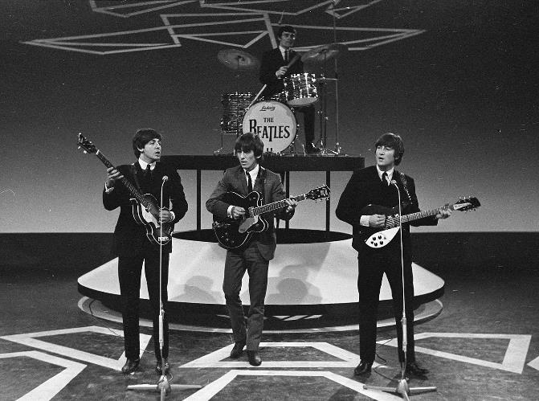
Famous Songs
Between 1962 and 1970, 214 songs were recorded by The Beatles.
They are currently the only group to have 20 songs become number one hits in the US.
Famous songs include:
All You Need Is Love
A Hard Day's Night
Help!
Yesterday
Hey Jude
With a Little Help from My Friends
Day Tripper
“The Beatles in Treslong te Hillegom” by Eric Koch / Anefois licensed under CC BY 2.0

Slide 16
Fun Facts
Strawberry Fields, the name of a song they wrote, is a real place near to where John Lennon grew up.
The Beatles initially struggled to get signed to a record label.
Most of their first album was recorded in one day.
At the beginning of their fame, while touring in Germany, George Harrison was sent home because he was too young to be allowed to perform in German nightclubs.
John Lennon was a huge Elvis Presley fan. He eventually met him while the Beatles were touring in the US but the meeting was not as successful as hoped.
Eric Clapton, another famous musician, played the guitar for their song, ‘While My Guitar Gently Weeps’.

