Slide 2
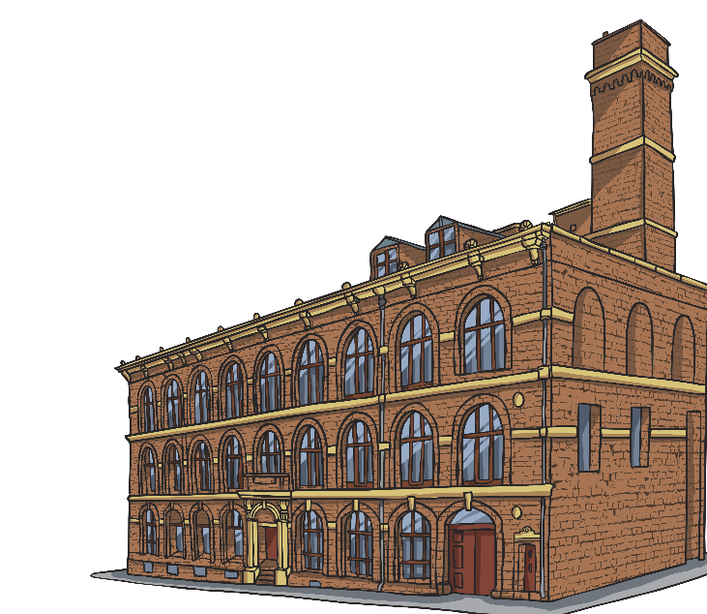
What Was the Industrial Revolution?
The Industrial Revolution was the period in which Britain changed from being a mainly agricultural country to being an industrial one. During this time, many people moved from small rural areas to cities and towns, in order to work in the factories that had developed. The Industrial Revolution began in the mid 18th century and continued to the end of the 20th century.
The Industrial Revolution was the result of discoveries and inventions that made manufacturing and transport easier, quicker and cheaper.
agricultural – Farming and growing crops.
industrial – Factories producing goods on a large scale.
manufacturing – Making items in large numbers using machines.
rural – The countryside.

Slide 3
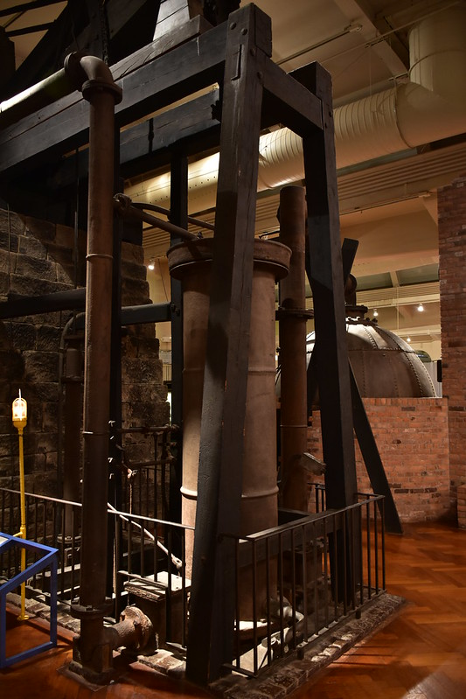
Newcomen’s Atmospheric Steam Engine
Thomas Newcomen was an inventor who was born in Devon in 1663. When working as an ironmonger, Thomas often provided goods for Cornish mines. These mines regularly suffered from flooding. The only way to ease the flooding was to manually pump the water out or use buckets. Newcomen decided to invent a machine that would drain water from flooded mines more quickly.
His atmospheric steam engine heated water which created steam in a chamber. The steam made a vacuum (empty space), causing the water to be sucked out of the mine.
The idea of using steam to generate movement was a key part of the Industrial Revolution. James Watt further developed the steam engine, inventing smaller versions that needed less coal.
“Newcomen Engine - Oldest Surviving Steam Engine in the World” by Amaury Laporte is licensed under CC BY 2.0

Slide 4
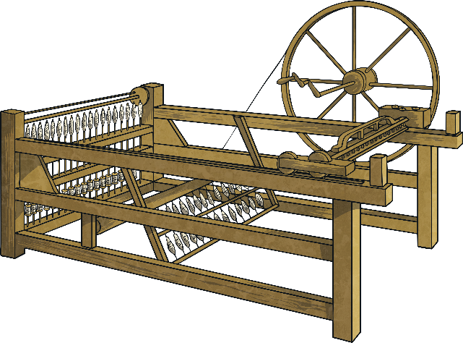
The Spinning Jenny
Before the Industrial Revolution, fabric was made using a spinning wheel. It was often done by people in their own homes. This way of manufacturing was called a ‘cottage industry’. The spinning jenny was invented by James Hargreaves in 1770. It was a machine that weaved cotton into fabric. The machine had eight wooden spindles.
When the wheel was turned, eight threads could be spun at once, which made the weaving process much quicker. Spinning jennies were used in factories.
Early in the Industrial Revolution, children as young as seven years old worked in factories for up to 14 hours a day.
Did You Know…?

Slide 5
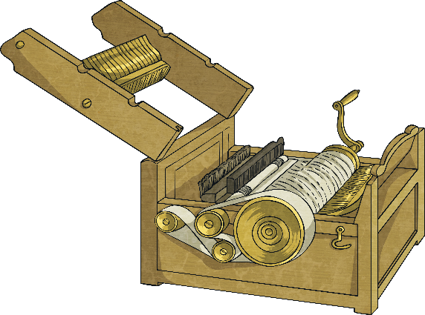
The Cotton Gin
The cotton gin was a machine that helped separate cotton fibre from its seeds. The raw cotton was put into the machine which had a drum inside it. As the handle was turned, the drum rotated and pulled the cotton in towards rotating brushes. The brushes then separated the seeds from the cotton. Prior to the invention of the gin, this job had to be done by hand and took a long time. The cotton gin made it quicker, easier and cheaper to provide cotton to the cotton industry across the world.
Although the cotton gin was an invention used in the USA, the cheaper cotton was provided to British cotton mills, which were growing rapidly.
The US cotton industry relied on the work of enslaved people. Because the cotton gin made it easier to process larger quantities of cotton, historians believe the invention led to the growth of enslavement in the USA.
Did You Know…?

Slide 6

Other Textile Industry Inventions
The Industrial Revolution saw many more inventions for the textile industry:
The Water Frame
In 1861, the US Civil War started, with President Abraham Lincoln leading the fight for the end of enslavement. His troops blocked cotton from being shipped to the UK. Cotton workers in Lancashire wrote to Lincoln to express their support for this and their wish for enslavement to end, even though it meant they were now out of work and facing starvation.
Did You Know…?
Invented by Richard Arkwright in 1769, the water frame was a spinning frame that could work continuously. It was very large and, as it was powered by a water wheel, needed to be by a fast-flowing river. The water frame meant large factories had to be built.
The Spinning Mule
This allowed one worker to operate 1000 spindles at once. The machine was invented by Samuel Crompton in 1779.
The Power Loom
This machine wove cloth much quicker than previous methods. It was invented by Edmund Cartwright in 1784. By 1850, there were 260,000 power looms being used in England.

Slide 7
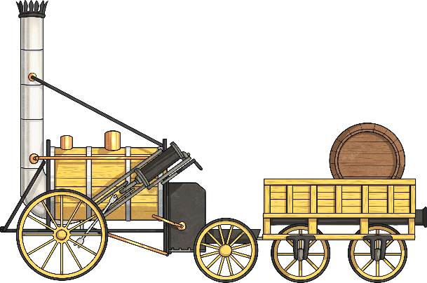
The Locomotive
The steam engine transformed transportation when it was used to create a locomotive. A locomotive is a vehicle powered by steam, electricity or other source of power, which is used for pulling trains. The first steam locomotive journey was when a steam engine, invented by Richard Trevithick, made a journey from an iron works to a canal in Wales in 1804.
In 1829, the Rainhill Trials were held to find an engine suitable to travel the Liverpool to Manchester railway. George Stephenson’s Rocket won the trials, averaging a speed of 12 miles per hour with a top speed of 30 miles per hour.
The railways became so popular that the 1840s became known as a time of ‘railway mania’.
Did You Know…?

Slide 8
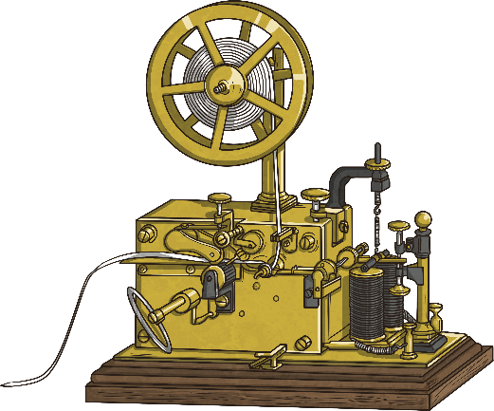
The Electric Telegraph
At the start of the Industrial Revolution, letters were the only way to communicate with someone who was far away and would be transported over land on horse drawn carts. Letters to someone in another country were sent via boat and could take months to arrive. In 1837, William Cooke and Charles Wheatstone invented a telegraph machine that would be used across the world. An electric telegraph sent messages via electric signals from one machine to another. Unlike modern wi-fi, the electric telegraph relied on wires. Many inventors helped to develop the telegraph. In 1858, the first transatlantic telegraph cable was laid under the Atlantic Ocean between the US and the UK. On 16th August of that year, Queen Victoria and US President James Buchanan exchanged telegrams.
The telegraph became well known in 1845 after a message was sent from the police to a train station master describing a man who had just committed a crime. The criminal was caught and arrested.
Did You Know…?

Slide 9
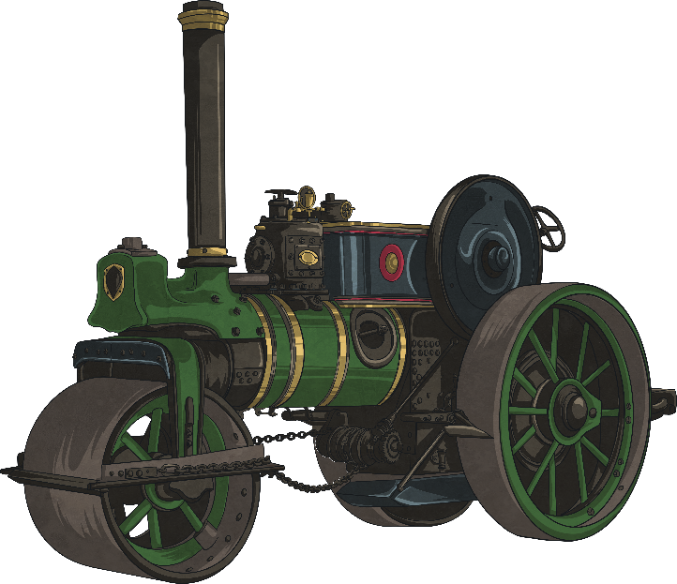
Transport
The Industrial Revolution saw other important improvements in transportation. The steam engine was used to develop steam ships. The first steamship to cross the Atlantic was the Savannah in 1819. The journey took just 24 days. Prior to steam, the journey could take six weeks or even longer depending on weather.
An invention called the internal-combustion engine led to the first car being developed by Carl Benz in 1885. That same year, an inventor called Gottlieb Daimler invented the first motorcycle.
How do you think the invention of the car changed the world?
Talk About It

Slide 10

Quiz
?
Who invented the atmospheric steam engine?
James Hargreaves
Thomas Newcomen
Richard Arkwright
?
What is the name of another invention for the textile industry during the Industrial Revolution?
Power wheel
Power loom
Power spindle
?
?
Where did the first steam-powered locomotion journey take place?
Wales
USA
France

Slide 11

Quiz
?
Which monarch sent a transatlantic telegram in 1858?
George III
Queen Elizabeth II
Queen Victoria
?
What year was the first car invented?
1785
1885
1985
?
?
How long did the first transatlantic steamship crossing take?
24 days
24 weeks
24 months

